Slide 1


Childcare Costs in America: A Growing Burden
Akshay Sharma
DSC640 – Data Presentation and Visualization
Summer 2025

Slide 2

Summary of Analysis
Analyzed National Database of Childcare Prices (2008–2018), focusing on Family Child Care (FCC) weekly costs for infants, toddlers, and preschoolers at the 75th percentile.
Used Python to explore national and regional trends in affordability and disparities.

Slide 3
Key Findings
Infant care is consistently the most expensive, increasing 17% over the decade.
Toddler and preschool costs also rose steadily ($17–$18).
Linear upward cost trend across all age groups.
Weak correlation between unemployment rate and infant care costs.
High variability in cost by state—MA, CA, and NY are most expensive.

Slide 4
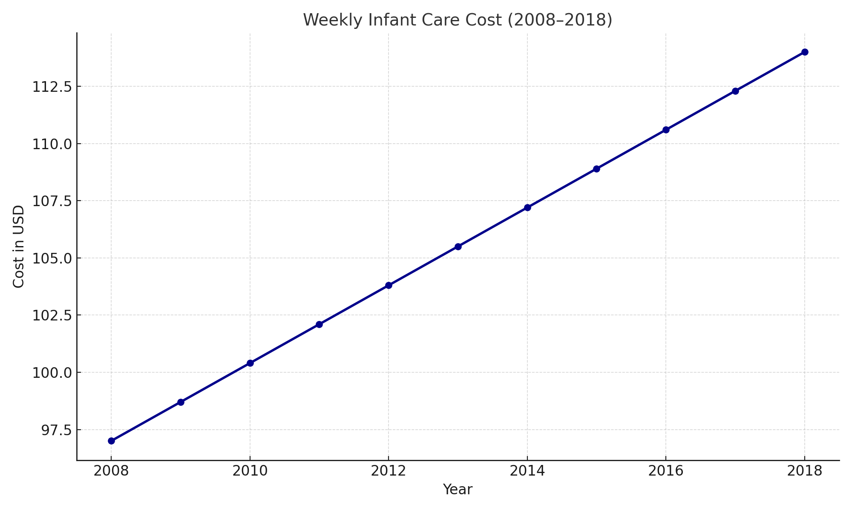
Infant Care Costs (2008–2018)

Slide 5
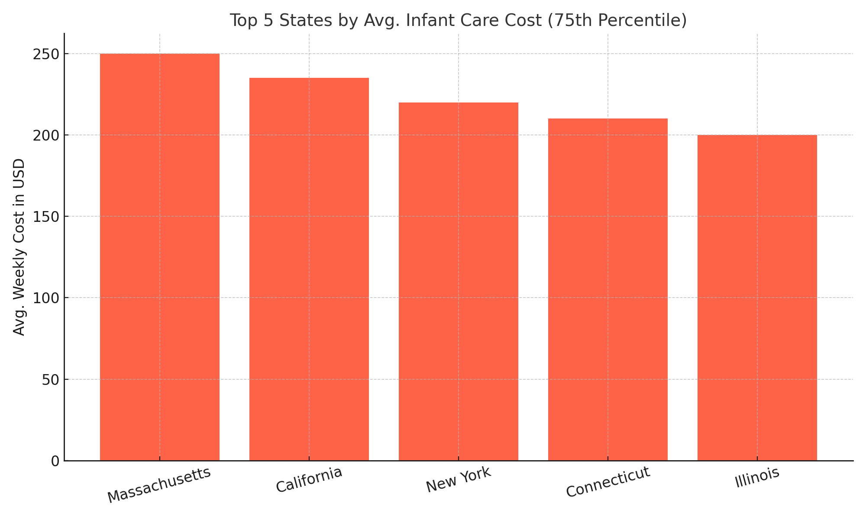
Top 5 States by Infant Care Cost

Slide 6
Assumptions
Data accurately reflects FCC market trends at 75th percentile.
Dataset represents all U.S. counties; focus was on national/state levels.
Did not model factors like provider availability or income inequality.

Slide 7

Ethical Considerations
Avoid implying causation from weak correlations.
Highlight regional differences to prevent overgeneralization.
Use color and icons responsibly to balance emotional appeal.
Clearly communicate data scope (e.g., focus on infants at 75th percentile).

Slide 8
Data Processing & Cleaning
Transformed Excel data to long format with 'weekly_cost' by 'age_group'.
Dropped missing values and standardized columns.
Converted study year to integer format and capitalized group labels.

Slide 9
Communication Mediums
Dashboard: Interactive, filterable tool for policymakers & researchers.
Infographic: Mobile-friendly, attention-grabbing summary for the public.
Slide Deck: Concise, data-driven story for executive audiences.

Slide 10
Dashboard Interactive, filterable tool for policymakers & researchers.
Designed for data-savvy audiences such as policymakers and researchers,
this interactive dashboard allows for a deeper,
self-directed exploration of the data.
Users can filter by state and year to uncover more
nuanced insights beyond the national averages.
Platform: Streamlit
Link: https://visualizationfinal-jfehrcpmnwfmpblmvo8uvn.streamlit.app/

Slide 11
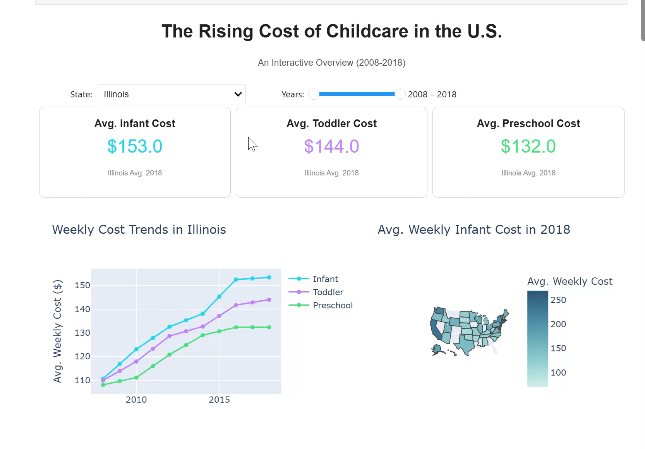
Dashboard: Illustration

Slide 12
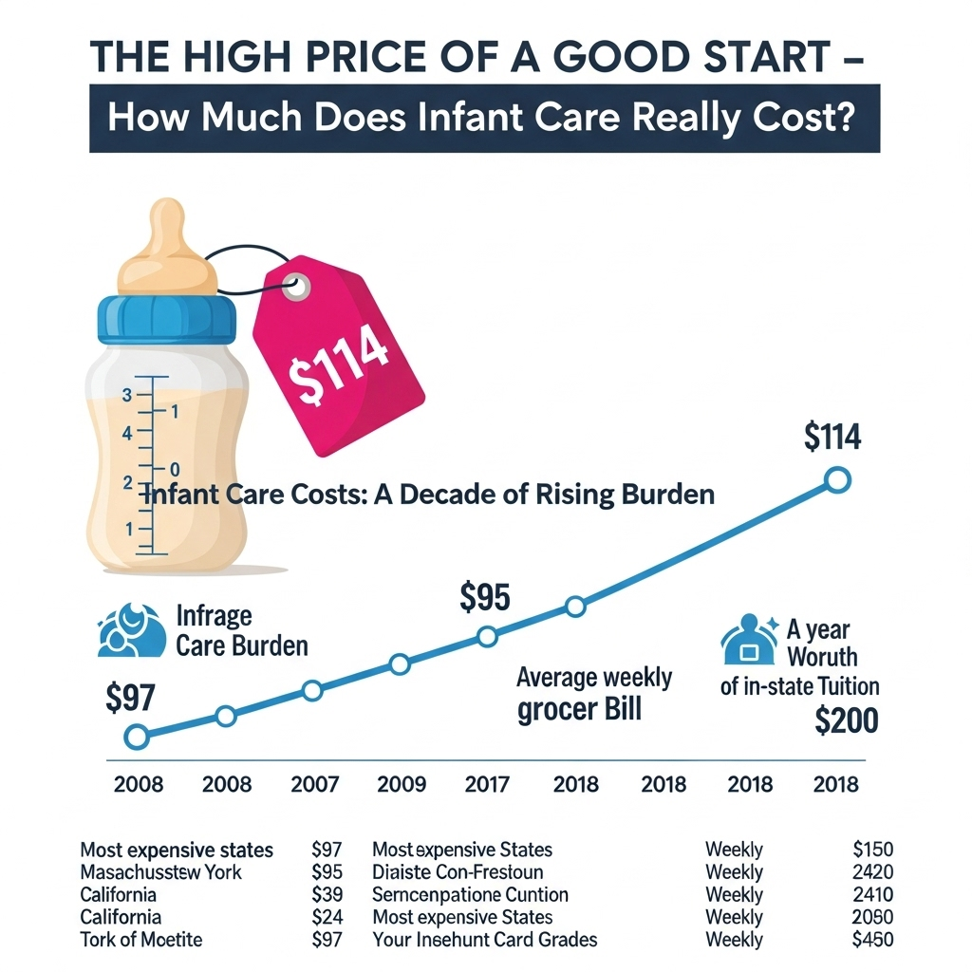
Infographic Tailored for the public, parents, and social advocacy groups on fast-paced platforms like Instagram and LinkedIn. The goal is instant understandability and emotional resonance. It distills complex data into a single, highly shareable image, focusing on the most impactful numbers (e.g., infant care costs) to raise widespread awareness and prompt conversation. .

Slide 13

Slide Deck Crafted for a formal, time-constrained audience of executives and policymakers. Its purpose is persuasion through concise, high-impact data storytelling. Each slide delivers one key message supported by clean, unambiguous visuals, framing childcare as an economic issue warranting intervention. It concludes with actionable, high-level recommendations.

Slide 14
Target Audiences
Policymakers: Guide policy decisions & childcare support.
Advocacy groups: Fuel equity campaigns.
Parents: Help with budgeting and expectations.
Researchers: Inspire deeper economic and labor studies.

Slide 15
Lessons Learned
Would integrate inflation and income data for affordability context.
Consider modeling economic factors and policies influencing cost.
Value of combining quantitative visuals with human-centered storytelling.

Slide 16

Closing & Contact
Data Source: National Database of Childcare Prices (NDCP)
Project conducted using Python, Matplotlib, and Plotly.
Contact: Akshay Sharma
Thank you for reviewing!

